Slide 1

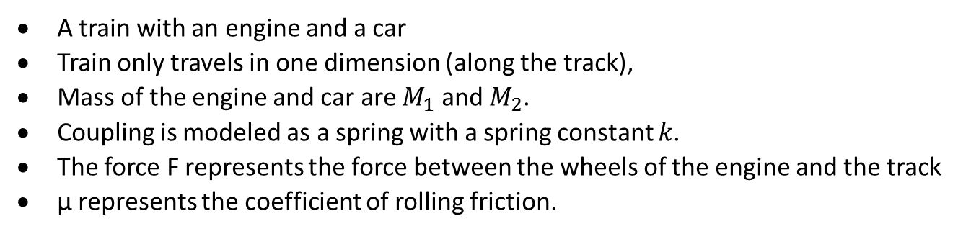
MECHANICAL SYSTEM MODELING: EXAMPLE #2 TRAIN SYSTEM
A train with an engine and a car
Train only travels in one dimension (along the track),
Mass of the engine and car are $M_{1}$ and $M_{2}$.
Coupling is modeled as a spring with a spring constant $k$.
The force F represents the force between the wheels of the engine and the track
μ represents the coefficient of rolling friction.
http://ctms.engin.umich.edu/CTMS/index.php?example=Introduction&section=SimulinkModeling

Slide 2
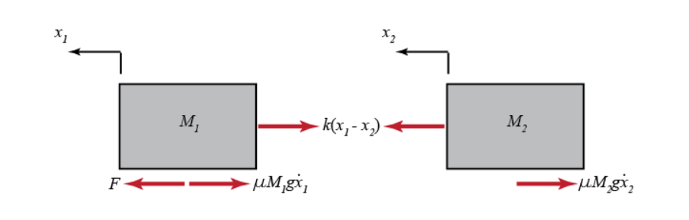
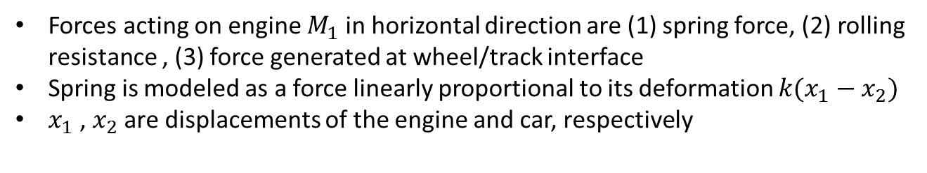
MECHANICAL SYSTEM MODELING: FREE BODY DIAGRAM
Draw the free-body diagram(s) representing the system.
Forces acting on engine $M_{1}$ in horizontal direction are (1) spring force, (2) rolling resistance , (3) force generated at wheel/track interface
Spring is modeled as a force linearly proportional to its deformation $k(x_{1}−x_{2})$
$x_{1}$ , $x_{2}$ are displacements of the engine and car, respectively
http://ctms.engin.umich.edu/CTMS/index.php?example=Introduction&section=SimulinkModeling

Slide 3
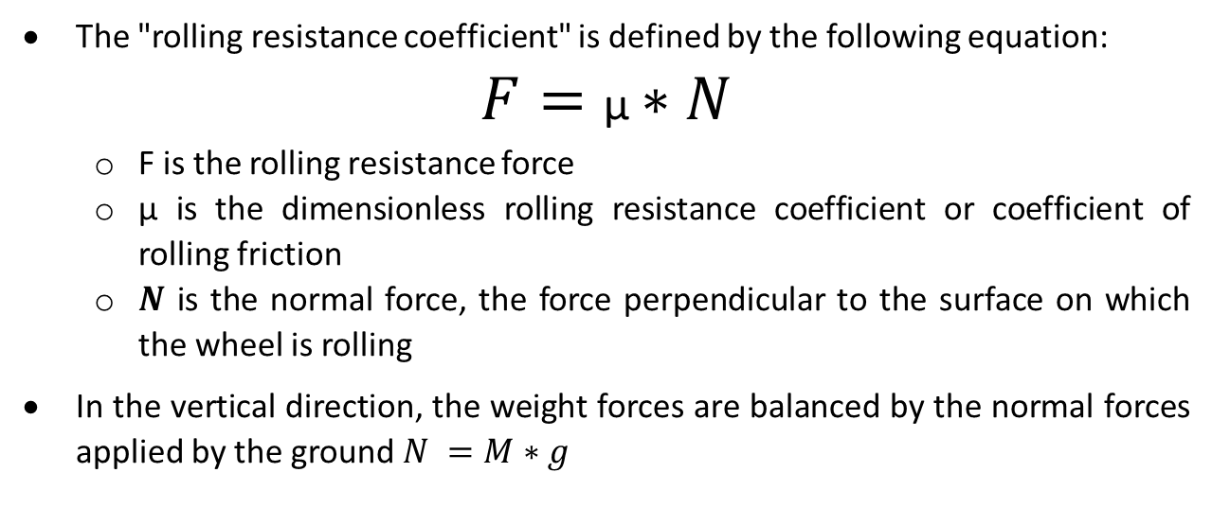
MECHANICAL SYSTEM MODELING: ROLLING RESISTANCE
The "rolling resistance coefficient" is defined by the following equation:
$$F=\text{μ}∗N$$
F is the rolling resistance force
μ is the dimensionless rolling resistance coefficient or coefficient of rolling friction
$N$ is the normal force, the force perpendicular to the surface on which the wheel is rolling
In the vertical direction, the weight forces are balanced by the normal forces applied by the ground $N =M∗g$

Slide 4
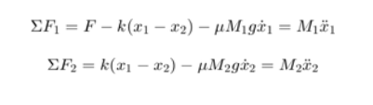
MECHANICAL SYSTEM MODELING: NEWTON’S SECOND LAW
Applying Newton's second law in the horizontal direction using these free-body diagrams:
http://ctms.engin.umich.edu/CTMS/index.php?example=Introduction&section=SimulinkModeling

Slide 5
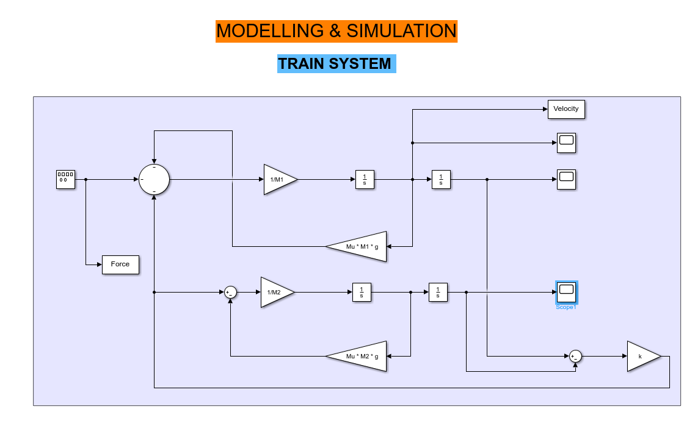
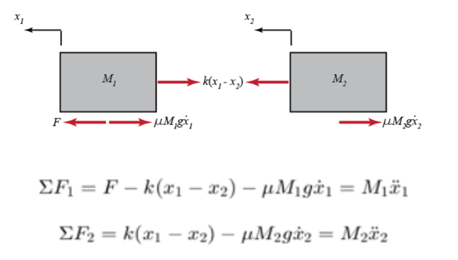
Modelling & Simulating Train System

